Slide 1
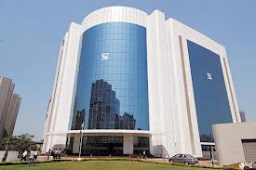
Primary Market
-
Initial Public Offerings (IPOs)

Slide 2

Disclaimer
Information contained in this presentation is as on September 30, 2022.
The information contained in this presentation is only for Educational and Awareness Purposes related to securities market .
This presentation is only for Educational and Investor Awareness Programs and shall not be used for any legal interpretations.
SEBI or Stock Exchanges or Depositories shall not be responsible for any damage or loss to any one of any manner from use of this material.
Suggestions or feedbacks, if any, may please be sent by mail to visitsebi@sebi.gov.in.
2

Slide 3
Flow of Presentation
Introduction to Primary Market.
IPO – Initial Public Offering: How to apply for Public Issues?
Rights & Responsibilities of A Shareholder.
Pre – Application Analysis.
Information in Offer Document.
Price Discovery of Shares: Fixed Price and Book Building Mechanism.
Allotment Intimation, Transfer of Shares and Debit/Credit of Funds.
Sample of Registrar and Transfer Agent (RTA) details on Company Website.
Checking Allotment Status and Grievance Mechanism.
Advice to Investors.
3

Slide 4
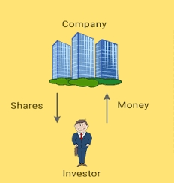
Introduction to Primary Market
New issues market where Company/ institutions raise funds or
capital from public by issuing new securities.
Objective: To raise capital.
Two major types of issuers of securities:
  Corporate Entities (Companies)
  Government (Central and State)
Major types of Issues in Primary Market:
  Public Issue
  Preferential Issue
  Rights Issue
  Bonus Issue
4

Slide 5
Introduction to Primary Market
Objects of Issue
New Projects
Expansion of existing projects/ modernization
Diversification
Up-gradation
Objects of the issue and intended utilization of funds
→ Given by issuers in the Offer Document
5

Slide 6
Introduction to Primary Market
Money Market
New Issues market (Primary market)
Financial markets
Securities Market
Capital Market
Secondary Markets
Other forms of lending and borrowing
6

Slide 7
Primary v/s Secondary Market : Key Differentiation
Features | Primary Market | Secondary Market
Definition | Securities issued first time to the public. | Trading of already issued and listed securities.
Also called as | New Issue Market. | Post Issue Market.
Price Determination | By Issuer Company in consultation with Merchant Bankers. | Supply and Demand Forces of Market.
Key Intermediaries | Merchant Bankers, Bankers/ Lead Managers, RTAs. | Stock Brokers and DPs.
Purpose | Raise capital for expansion, diversification, etc. To seek listing of securities. | Trading of securities. Providing liquidity to investors. Raising further capital for expansion.
7

Slide 8
Modes of Public issues
Issues
Public Issues
Rights Issues
Bonus Issues
Private Placements
Preferential Issue
Qualified Institutional Placement
IPO
Fresh Issues
Offer for sale
FPO
Fresh Issues
Offer for sale
8

Slide 9
Modes of Capital Issuances
IPO
Initial Public Offering.
Done by unlisted company.
Fresh issue of securities/ offers its existing securities for sale/ Combination of both.
Securities issued for the first time to the public.
Paves way for listing and trading of the issuer’s securities in the Stock Exchange(s).
FPO
Further Public Offer / Follow-on Offer.
Done by already listed company.
Fresh issue of securities / Offer for sale of securities to public .
Rights Issue
Done by already listed company.
Issue of securities to its existing shareholders (as on a Record date).
Record Date is fixed by the issuer.
The rights offered in a particular ratio to the number of securities held by existing shareholders as on the record date.
9

Slide 10
Modes of Capital Issuances
Bonus Issue
Done by already listed company.
Issue of shares to existing shareholders (as on a record date).
Existing shareholders need not make any payment for “Bonus” shares.
Shares are issued out of the company’s free reserve or share premium account.
Issued in a particular ratio to the number of securities held on record date.
Preferential Issue
Done by already listed company.
Issue of shares / convertible securities (like warrants) to a select group of persons.
Subject to prescribed norms such as minimum pricing, minimum public shareholding and lock-in.
Qualified Institutional Placement.
Done by already listed company.
Issue of shares / convertible securities (like warrants) to Qualified Institutional Buyers (QIBs).
Subject to prescribed norms such as minimum pricing and minimum public shareholding.
QIP
10

Slide 11
IPO - Initial Public Offering
Process of a company to be publicly listed and traded company.
IPO: Fresh issue of shares / Offer for Sale of shares by existing investors/ Combination of both.
Process of IPO is as follows:
Issuer files an Offer Document in prescribed format with Securities and Exchange Board of India (SEBI), Stock Exchanges and the Registrar of Companies (ROC) for listing on the stock exchanges
Issuer receives observations from regulatory authorities
After complying with all observations, issuer can open the offer inviting general public to invest in the IPO subject to stipulated timelines
Post successful completion of the Offer the shares of the company are traded on the stock exchange(s) where the shares are listed.
11

Slide 12
How to apply in Public Issue?
ONLINE MODE
ASBA | Application Supported by Blocked Amount. Facility provided by Self Certified Syndicate Banks (SCSBs) Full Bid Amount blocked in the bank account of the bidder.
UPI in ASBA | For → | Retail Individual Investors. Shareholders bidding in Shareholders Reservation Portion up to Rs.5,00,000/-.
 | Application via UPI facility of Sponsor Bank.
3-in-1 Account | Applying in IPO through 3-in-1 account (demat, trading and bank account).
OFFLINE MODE
Filled Form | To open a Demat Account first. Investors may obtain Application Form from Stock Broker/ Sponsor Bank/ Exchange Website. Form submitted to Stock Broker/ Sponsor Bank.
12

Slide 13
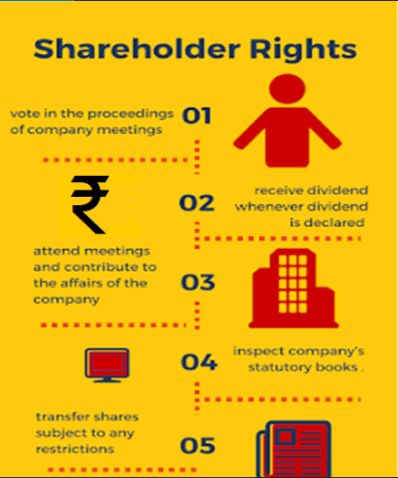
Rights of a Shareholder
Part-owner of the company, in proportion to their holding in the company.
Right to receive corporate benefits like dividend, whenever declared.
Right to receive:
Annual Reports
Audited Financial Statements
Notices of General Meetings and other notices
Other information disseminated by company.
Right to attend company meetings.
Right to contribute in key corporate governance decisions through postal ballot/ e-voting.
13

Slide 14
Rights of a Shareholder
(subject to certain limitations/ restrictions)
Right to:
Ask questions to the board of directors.
Place items on the agenda of general meetings.
Propose resolutions, etc.
Right to participate in matters needing shareholder approval like:
To vote in company proceedings.
To approve mergers & acquisitions, appointment of directors on company board, changing auditors, etc.
Right to Inspect company’s statutory books and records.
Right to Transfer shares by applicable laws.
To raise grievances, if any, against the company (using SCORES, etc.).
14

Slide 15
Responsibilities of Shareholder
Stay informed!
ANNUAL REPORT :
  Circulated to all Shareholders (via Post / Email).
  Available on website of Company and Stock Exchanges.
  NOTICE : for shareholder meetings with details of the agenda.
  MD’s NOTE : the managing director's note in the annual report to understand how the business is doing.
  AUDITOR’s NOTE : check if there are any red-flags / adverse findings flagged.
INFORMATION ON STOCK EXCHANGE WEBSITE :
  Company’s structural changes, updates, press release, investor presentations etc. under corporate announcements, which any investor should refer to.
15

Slide 16
Pre-Application Analysis : Broad Contours
Product, Plant and Pricing
Investors should take a well-informed decision of investing / applying in an IPO / FPO / Rights issue.
Don’t go by mere rumours / euphoria over expected returns as what the others feel.
Invest based on one own risk appetite and investment parameters.
Sustainability & Growth
Points to be considered as a part of pre-application analysis (before investing / applying in an IPO/ FPO / Rights application).
Scalability and Addressable Market
Business Beyond Numbers
Management Quality
Sustainable Margins: Absolute & Relative
Stakeholders Behavioral Pattern
Corporate Governance
Corporate Structure
Business Succession
16

Slide 17
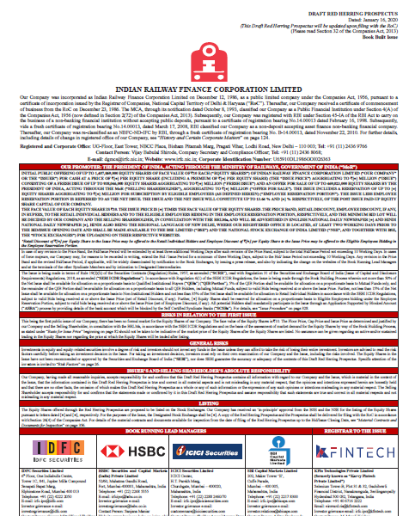
Information in Offer Document –
Sample Snapshots
17

Slide 18
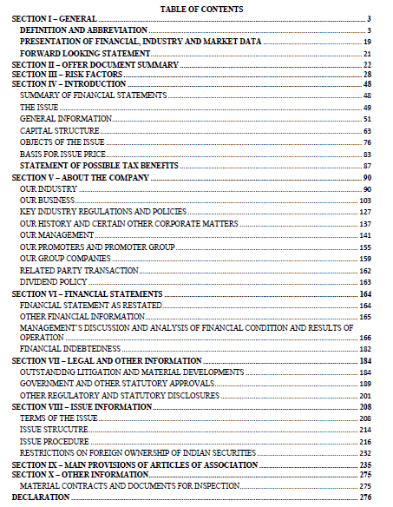
Information in Offer Document –
Table of Contents
TIP:
Before investing in any prospective offering of shares, always go through such offer documents, available on websites of SEBI and Merchant Bankers.
18

Slide 19
Information in Offer Document
About the Company:
- Business: Company’s business model, strategies and manufactured products/ process/ services.
- History and Corporate Matters: Material events taken place in company’s history and other corporate matters
Management and Promoter Section
- Background and the experience of the company’s management team.
Financials
- Company's income statement and balance sheet.
- Understand company’s past performance and growth potential.
Risk Factors
- Risks associated with the business, industry etc.
Litigation and Dispute matters
- Litigations in which the issuer company, subsidiary(ies), group company(ies), promoter(s) are involved.
19

Slide 20
Information in Offer Document
Capital Structure
- Capital formation of the company,
- Existing shareholders and their percentage shareholdings etc.
Objects of the Issue
- Basic purpose of the company for going public and / or raising funds.
- Informs how the funds will be utilized.
Basis for Issue Price
- Helps understand the basis for pricing
- Comparison with other listed entities in the same / similar segment.
Managements discussions and Analysis of financial conditions and results of operations
- Information related to the strength of the company's business plan, recent developments, performance etc.
- Performance analysis with qualitative and quantitative measures.
20

Slide 21
Other key Sources of Information for Analysis
Research Reports
ROC Filings made by the Company since Inception;
Minutes of the meetings of the Board / Shareholders of the issuer company
Industry Reports;
Collaboration Agreements/Shareholders Agreements
Credit Ratings;
Third Party Reports/certification on project;
Techno Economic Viability Reports etc.
21

Slide 22
Price Discovery of Shares in a Public Offering
IPO
Fixed Price issue
Type of Issue
Mode of Price Discovery
Book Building Issue
More common mode of IPO
22

Slide 23
Price Discovery of Shares in a Public Offering - Fixed price issue
Fixed price issue:
Price at which the securities are offered and will be allocated is fixed by Company along with Merchant banker
Fixed price is printed in the Offer Document, usually along with reasoning behind the price at which shares are offered.
Demand for the securities offered is known only after the closure of the issue.
50% of the shares offered are reserved for applications below Rs. 2 lakh and the balance for higher amount applications.
23

Slide 24
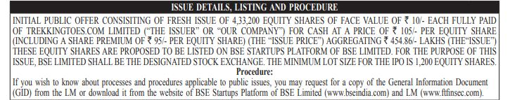
Price Discovery of Shares in a Public Offering - Fixed price issue
Illustration of Fixed Price Issue:
  First page of the prospectus contains:
  Number of shares to be issued
  Price of issuance
  Price is already fixed prior to the IPO. No price discovery mechanism is used.
  All application for shares have to be made at the price mentioned else they are considered as invalid bids.
24

Slide 25
Price Discovery of Shares in a Public Offering
Book Built Issue:
Company may offer a maximum of 20% price band in which one can bid for shares.
Floor Price: Lower end of Price Band
Cap Price: Higher end of Price Band
Eg: Rs.100/- to Rs.120/-
Issuance Price discovered on the basis of demand at various price levels (within Price band)
Investors must specify:
- Number of shares they want to buy.
- Price they are willing to pay per share (within the price band).
Price Band is independent of Face Value (FV) of shares.
25

Slide 26
Price Discovery of Shares in a Public Offering
Stages in Book Building:
Company who is planning an IPO appoints the Lead Merchant banker(s) as “Book Runner”.
Investors give their bids for these shares to “Syndicate Members”. Bids have to be entered within the specified price band. Investor can revise a bid before the book closes.
Syndicate members input the orders into an “Electronic Book” through process called “Bidding”.
Book normally remains open for a period of 5 days.
On closure of the book building period, the Book Runner evaluates the bids on the basis of the demand at various price levels.
Book runners and the issuing Company decide the final price at which the securities shall be issued.
Finally allocation of securities is made to the successful bidders. Money gets unblocked in bank accounts of rest of the bidders.
26

Slide 27
Price Discovery of Shares in a Public Offering
Illustration of Book Building issue:
  Price band = Rs. 20.00 (Floor Price) to Rs. 24.00 (Cap Price) per share
  Total available shares (issue size) = 3,000 shares.
  Company received five bids from bidders as mentioned below:
  Price discovery is a function of demand at various prices.
  Highest price at which the issuer is able to issue the entire size of 3000 shares is the price at which the “book cuts off” = Rs. 22.00.
  The issuer, in consultation with the Book Running Lead Manager will finalize the issue price at or below such cut-off price, i.e., at or below Rs.22.00.
  Valid Bids: All bids at or above this issue price and cut-off bids (allowed for retail investors only) and they are considered for allocation in the respective categories.
Bid Quantity | Bid Price (Rs.) | Cumulative Bid Quantity | Subscription
500 | 24 | 500 | 16.67%
1,000 | 23 | 1,500 | 50.00%
1,500 | 22 | 3,000 | 100.00%
2,000 | 21 | 5,000 | 166.67%
2,500 | 20 | 7,500 | 250.00%
27

Slide 28
Book Building v/s. Fixed Price Issue
Features | Fixed Price Process | Book Building Process
Pricing | Price at which securities are offered /allotted is known in advance to the Investor. | Price at which securities will be offered/allotted is not known in advance to the investor. An indicative price range is known.
Cut off price | Price is fixed in this process. | Only the Retail Individual Bidders are permitted to bid at a cut off price which makes the application valid irrespective of any discovered issue price with in the price band.
Demand | Known only after the closure of the Issue. | Demand can be known everyday as the book is built.
28

Slide 29
Process Flow : Fixed Price Method
Issuer Appoints SEBI Registered Intermediary except Syndicate Member
Determination of Issue period & Issue Price
Filing of Prospectus with ROC
Applicant submits application form to Intermediary for uploading on Stock Exchanges platform
Issue Opens
Issue Closes
Completion of Post Issue Compliances
Due Diligence
Lead Manager files Draft Prospectus with SEBI/Stock Exchange
Receipt of In-Principle Approval from Stock Exchange and observations from SEBI
29

Slide 30
Process Flow : Book Building Method
Issuer Appoints Merchant Banker, Legal Advisor, RTA, Syndicate Member, Underwriter etc.
Determination of Issue period & price band
Filing of Red Herring Prospectus with ROC
Applicant/Bidder submits application form to Intermediary for uploading on Stock Exchanges platform
Issue Opens
Issue Closes
Completion of Post Issue Compliances
Due Diligence
Book Running Lead Manager files Draft Red Herring Prospectus with SEBI/Stock Exchange
Receipt of In-Principle Approval from Stock Exchange and observations from SEBI
30

Slide 31
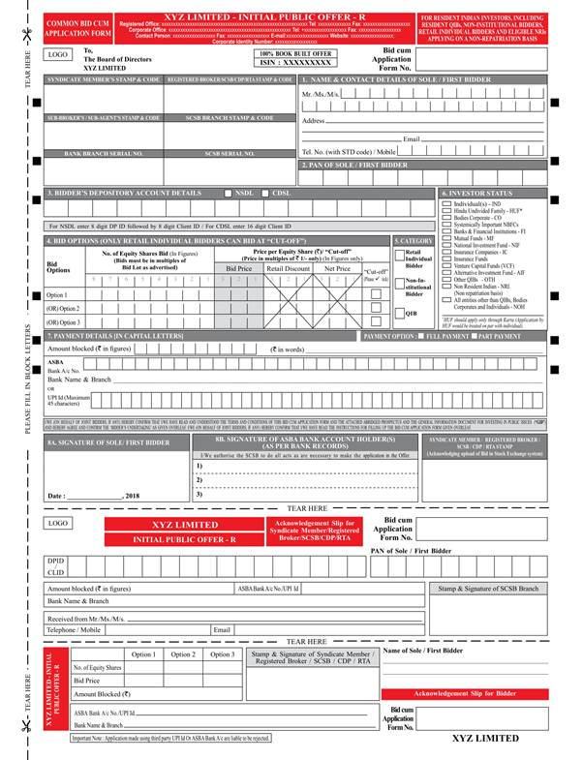
Book Building Process : Sample Form
Investors may refer this application form – filled for applying in the IPO.
Only Retail Individual Bidders have the option to tick at the ‘cutoff price’.
Others need to specify the price (within the price band) at which they wish to apply.
Forms available on websites of BSE and NSE
31

Slide 32
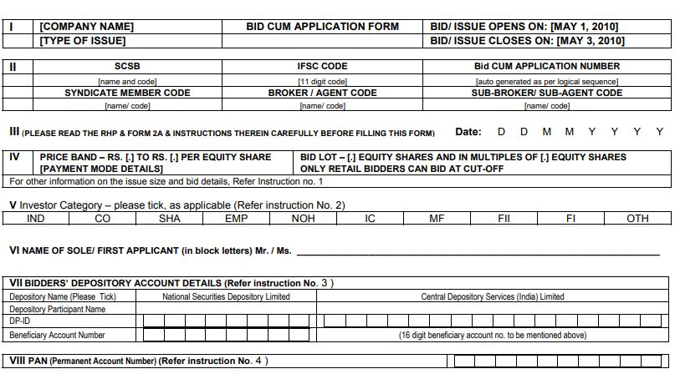
Sample Application Form
32

Slide 33
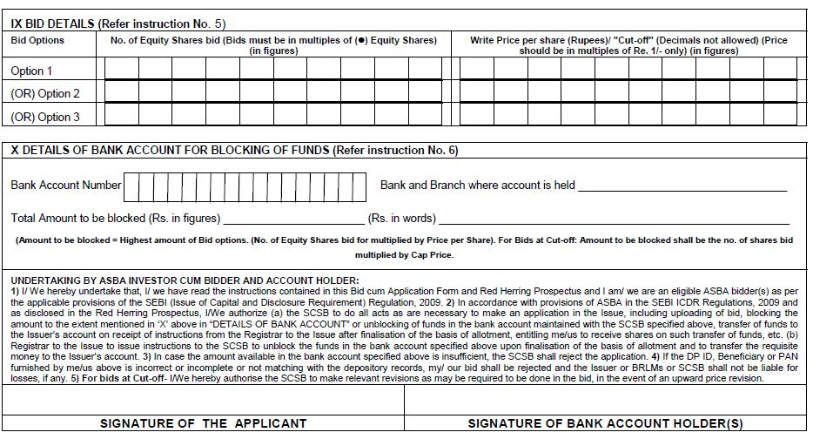
Sample Application Form
33

Slide 34
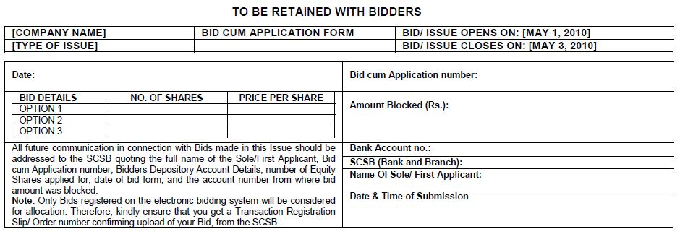
Sample Application Form
Sample is only for illustrative purpose and may not be exactly same as actual application form
34

Slide 35
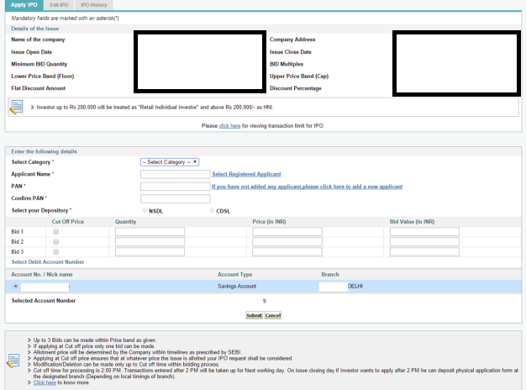
ASBA Application via Online Mode
Source : https://www.onlinesbi.com/
35

Slide 36
IPO Application Form via UPI
Create UPI ID with any of IPO enabled BHIM UPI apps
Enter UPI ID on IPO Application
Check notification on your BHIM UPI app and approve
Check application details and proceed
Enter UPI PIN to approve the mandate block
Confirmation of transaction
Source : https://www.bhimupi.org.in/
Mobile Number mentioned in IPO application must match with Mobile Number linked to bank Account and UPI ID
36

Slide 37
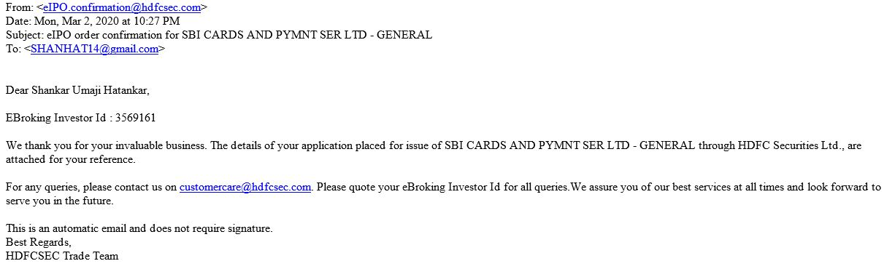
Illustration for IPO Application Confirmation
(From bank / Stock Broker)
37

Slide 38
Allotment Intimation, Transfer of Shares and Debit/Credit of Funds
Basis of Allotment :
Finalized by the Company with the Lead Mangers, Registrar to Issue, and Stock Exchanges.
Published and gives details of category wise demand for shares and how shares have been allotted.
Intimation of allotment to applicants :
Made through ordinary post / SMS/ Email.
Available on the website of the Registrar to an Issue (RTI)
Compensation to Retail Individual Investors in an IPO
Compensation for opportunity loss due to non-allotment of shares if failure is on account of Self Certified Syndicate Banks(SCSBs)
Compensation paid if listing price is more than issue price
Apply for compensation within three months of the listing date
38

Slide 39
Allotment Intimation, Transfer of Shares and Debit/Credit of Funds
Issue gets oversubscribed (demand > shares available for subscription) → Shares are allotted on proportional basis / lottery system.
Registrar prepares and releases the fund transfer instruction for transfer of funds to Public Issue and unblocking of funds wherein bidders have not received allotment.
Registrar also gives instructions to NSDL and CDSL for credit of Equity Shares to the successful Bidders as specified in the Offer documents.
Date of allotment and date of listing of the shares can be checked in the Offer Document.
39

Slide 40
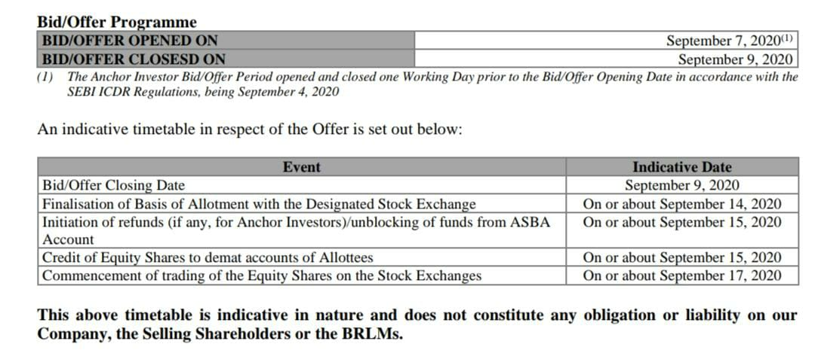
Illustration for checking details of Allotment and Listing Dates
These details can be found in the Section on “Offer related information – Terms of the offer”.
40

Slide 41
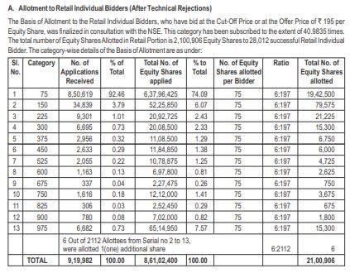
Illustration for Basis of Allotment
41

Slide 42
Checking Allotment Status and Grievance Mechanism
Status of allotment/ refund related to IPO application →
  informed to investors by SMS/ email/ letter.
  May be checked by visiting “Investor Services” section on the website of the Registrar and Transfer Agent (RTA) for the Issue on the indicative Allotment Date mentioned in the Offer Document.
Issue with regard to Non-allotment of shares / Refund etc. →
  Contact RTA immediately.
Non-Satisfactory Resolution by RTA -> File a complaint against RTA with SEBI on:
SEBI SCORES website/ Mobile App (on Android and iOS platform)
42

Slide 43
Checking Allotment Status and Grievance Mechanism
Contact Details of Registrar and Transfer Agent (RTA):
  Provided in Offer Document of IPO
  Available on SEBI Website at:
https://www.sebi.gov.in/sebiweb/other/OtherAction.do?doRecognisedFpi=yes&intmId=10
Non-Satisfactory Resolution by RTA -> File a complaint against RTA with SEBI on:
  SEBI SCORES website/ Mobile App (on Android and iOS platform)
43

Slide 44
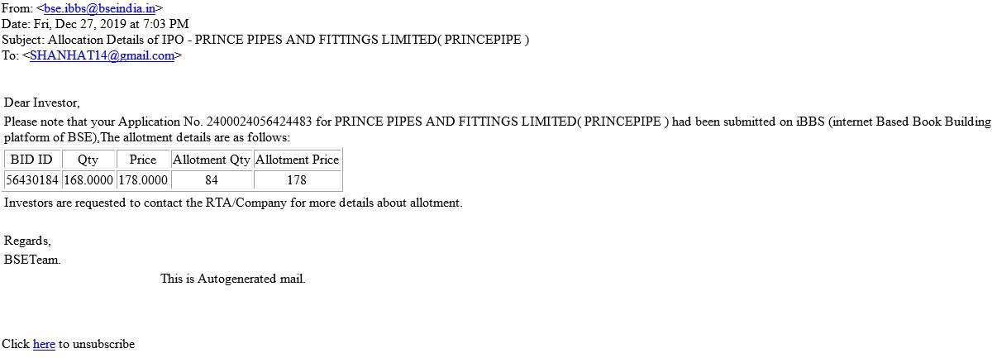
Illustration for Allotment Status
(Email)
44

Slide 45
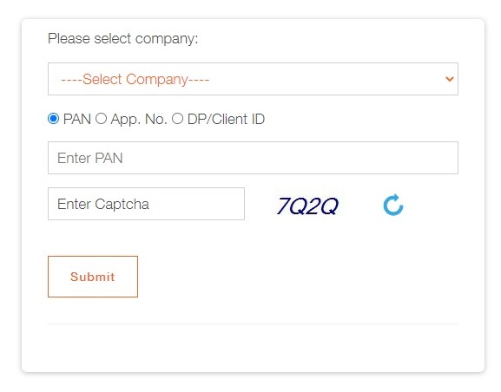
Illustration for Allotment Status on RTA Website
45

Slide 46
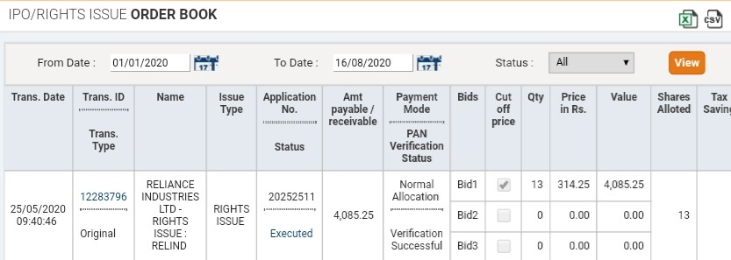
Illustration for Allotment Status
(Bank / Stock Broker Website)
46

Slide 47
Advice to investors
Do not deal in shares in Black market / Grey Market
Invest in IPOs for the long term.
One person (identified by PAN number) is permitted to make only one application in an IPO.
Use your own funds to apply for an IPO. Funds routed through any Third-party is not allowed as valid payment.
Don’t invest with anticipation of making quick profits on listing of shares.
47

Slide 48


Additional Information
For further information, you may visit the following web-sites and Mobile App:
  www.sebi.gov.in/
  https://investor.sebi.gov.in/
  Saa₹thi App
For Grievance Redressal, you may visit following website:
  www.scores.gov.in/
Or, you may call SEBI at following Toll-free Helpline Numbers from 9:00am to 6:00pm on all days (excluding declared holidays in the state of Maharashtra):
  1800 266 7575
  1800 22 7575
Helplines are available in 8 Languages:
English, Hindi, Bengali, Gujarati, Marathi, Kannada, Telugu and Tamil
SEBI : HAR INVESTOR KI TAAQAT
48

Slide 49
Thank You
49

